Slide 1

Slide A
Introduce Synthesis Task for Design Pitch
Final Design Pitch
After engineers have developed a design per stakeholder requests, done market research, and tested the product, they use all this to develop a design pitch before going into the full development stage. Today you will use everything you have collected as feedback about your design and put together a design pitch.
Notes:
Introduce students to the synthesis task. Display slide A.
Say, When engineers are working on a design solution they will compile all their evidence, research, and data and use it to inform decisions as they develop prototypes, drawings, and representations of their design solutions and write up their argument or recommendation of how and why a solution should be designed before moving forward with manufacturing. In the first part of class today, you will use all the materials from Lesson 14 to put together a design pitch for your design. Your design pitch should explain why your final design is effective and should be made. In your pitch include the trade-offs you have made and how you justify these trade-offs to the stakeholders. How would you explain the consequences of changing an aspect that the stakeholders were wanting in a design to something else, and how will this change benefit them and the design as compared to their original request?

Slide 2

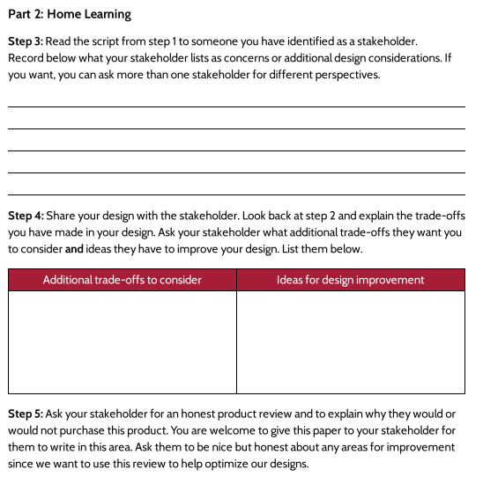
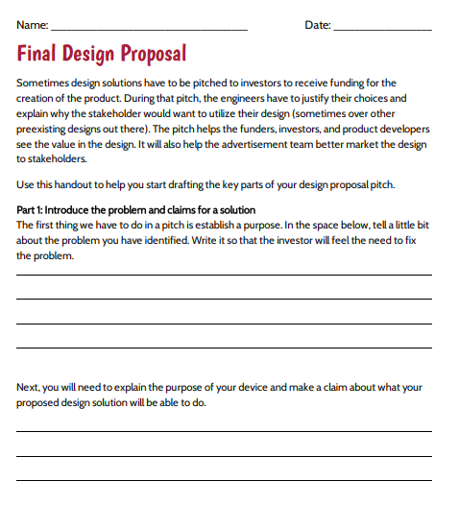
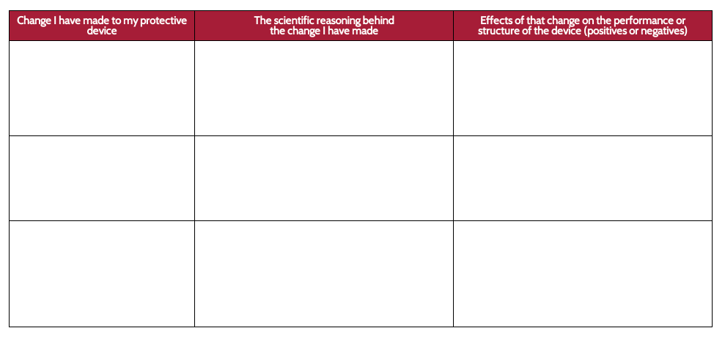
Slide B
Construct Your Design Pitch
Final Design Proposal
Use all the work you have done and resources you have to put together a written design pitch, including
the purpose of your design (What it will protect?),
the materials it will be made of and why, and
the trade-offs you made and why.
Market research
Redesign and trade-offs
Notes:
Give students 20 minutes to write their final proposal for their design. Project slide B. Tell students they should have out and be ready to use any resource material from their notebook, their Redesigning Your Protective Device, their Decision Matrix, and their Stakeholder Feedback Form as they complete Final Design Proposal. Pass out Final Design Proposal. Say, You may notice you already have ideas for some of the sections on this handout on one of the handouts from Lesson 14. In that case, you may just be transferring your ideas to this document. Other sections may require more thought. Read the questions carefully and compare them with the work you have already done on your designs. Some portions of the handout may need only a little more revising or thought for your presentation proposal for potential investors.
Say, Though you’ve got some great ideas for how to improve your designs for our consumers, how could you use this way of thinking to evaluate and test designs that other engineers come up with for any proposed collision mitigation design solution? You will now use what you have figured out about contact forces and designing solutions and apply it to a new phenomenon scenario. This will be your final assessment of our unit.

Slide 3
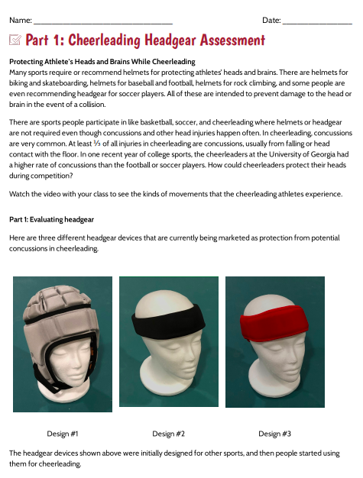
Slide C
Part 1 Transfer Task
There are two parts to this transfer task. You will work on part 1 today and will do part 2 next time.
Let’s read through the first part together. Then we will watch a short video clip to provide you context for the device you will be evaluating.
Notes:
Distribute Part 1: Cheerleading Headgear Assessment to each student. Show slide C. Take a few minutes to go through the directions for the different sections of the transfer task. Then read the assessment introduction.
Show a cheerleading video to the class. Take a moment to show a video from the list below. Alternatively, any other cheerleading video that shows the aerial gymnastics of the sport can be shown.
https://www.youtube.com/watch?v=yaljRoKZVvg
https://www.youtube.com/watch?v=lcUO6BX4a9Y
https://www.youtube.com/watch?v=Ospfvnn1neE
It is advised you should show at least half the video so students can see what this sport looks like, especially in a competition. This will help them think about the idea of adding helmets to the uniform for cheerleading. Answer any questions students may have about what the questions are asking of students. Give students time to complete part 1 of the assessment on their own.
Conduct the end of part 1 of the transfer task. Ask students to pause where they are at on the assessment and turn part 1 in. Let them know that the rest of the part 1 assessment can be completed tomorrow if they are not finished. It can be helpful to keep separate the assessments that are from students who have completed part 1 and ones from students who have not finished and may need a few minutes to finish at the beginning of the next class.

Slide 4
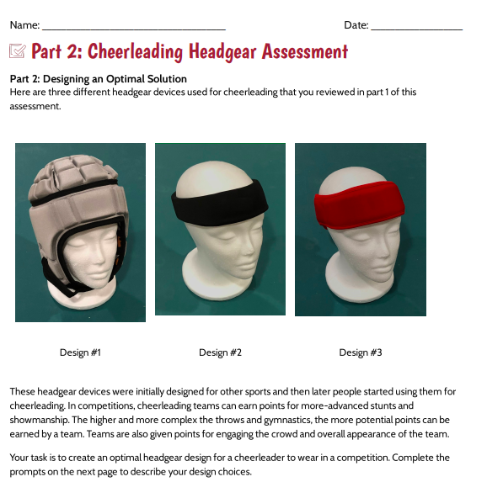
Slide D
Part 2 Transfer Task
Today you will work on part 2 of the transfer task for the first part of class.
Notes:
Distribute Part 2: Cheerleading Headgear Assessment to each student. Show slide D. Take a few minutes to go through the directions for the different sections of the transfer task. Answer any questions students may have about what the questions are asking of students. Give students time to complete part 2 of the assessment on their own. You will also want to hand back part 1 to anyone who had not finished it in the prior class period. After 20 minutes, collect all transfer tasks. Most should have already finished by this time, but if there are still a few who are not finished, you may need to offer them time outside of class or, if it works logistically, they could finish the task and then join the class in revisiting the DQB when they finish.

Slide 5

Slide E
Revisit Our Driving Question Board
Which questions have we made the most progress on?
What have we figured out?
Place a green index tab flag on any questions you feel you could fully answer. It is OK if there are other green sticky dots there too.
Use a yellow index tab flag for any questions you can partially answer.
If there are any questions you feel you can’t answer at all, leave them without any sticky dots.
Notes:
Display slide E as students are finishing the assessment. As students finish the transfer task and have turned it in, tell them to take a few of the index tab flags and silently visit the DQB. Using the directions slide E, they should read through the questions and put sticky dots on any that they feel they can answer.
Convene in a Scientists Circle around the Driving Question Board. Look for patterns using the index tab flags. In the Scientists Circle, focus on the questions that have the most number of sticky dots.
Discuss as a class the questions the class can now answer. Have the class discuss the answers to those questions as a group. If you have space, you might make a Take-Aways board that has a record of the answers the class comes up with.

Slide 6
Slide F
Quick Write: Reflect on Our Experiences
Quick Write
Answer the following questions in your science notebook.
What was most challenging in this unit?
What was most rewarding?
Think about how you engage in sensemaking discussions with classmates. How would you want to engage in those experiences the next time around?
  What would you do the same?
  What would you do differently?
Notes:
Celebrate the class’s accomplishments. Say, I can’t believe how far we have come since we first wondered about the phenomenon of why smart phone screens break sometimes and not other times. We should be very proud of what we have accomplished!
Have students reflect on their experiences with the unit. Have students return to their regular seats. Prompt students to find a new page in their science notebook and title the page “Reflection.” Display slide F. Give students about 5 minutes to write a personal reflection on their learning based on the following prompts:
What was most challenging in this unit?
What was most rewarding?
Think about how you engaged in sensemaking discussions with classmates. How would you want to engage with those experiences the next time around?
What would you do the same?
What would you do differently?
As a whole group, ask each student to share part of their reflection. Taking time to reflect upon the process of this unit can allow students to think metacognitively about what works well for them as learners.

